Slide 1
PROFESSIONAL ETHICS (HUT 200)
Module II
ENGINEERING ETHICS AND
PROFESSIONALISM

Slide 2
Syllabus
Senses of Engineering Ethics - Variety of moral issues- Types of inquiry- Moral dilemmas –Moral Autonomy – Kohlberg’s theory- Gilligan’s theory-Consensus and Controversy-Profession and Professionalism- Models of professional roles - Theories about right action – Self interest -Customs and Religion- Uses of Ethical Theories.

Slide 3
Introduction
Profession is a commitment to a designated and organized occupation by virtue of being an authority over a body of knowledge with requisite skills acquired through specialized training.
Professional ethics is a set of ethical standards and values a practicing engineer is required to follow.
A code of ethics prescribes how professionals are to pursue their common ideal at a minimal cost to oneself and those they care about.

Slide 4
Ethics in Engineering
Ethics in engineering is the ability as well as the responsibility of an engineer to judge the decisions from the context of the general wellbeing of the society.
Professional engineering bodies and other organizations have evolved comprehensive ethics codes relevant to their respective professions.

Slide 5
Factors Influencing Ethical Standards in Engineering
Engineering as an experimentation for the good of mankind is a notable factor involving far reaching consequence,
Ethical dilemmas make engineering decisions relatively difficult to make.
Risk and safety of citizens as a social responsibility is a prime concern of an engineer,
Technological advancement can be very demanding on the engineering skill in the global context,
Moral values and responsible conduct will play a crucial role in decision making.

Slide 6
Senses of Engineering Ethics
Senses are related to each other
Normative
Knowing moral values, finding accurate solutions to moral problems and justifying moral judgments in engineering practices,
Study of decisions, policies, and values that are morally desirable in the engineering practice and research, and
Using codes of ethics and standards and applying them in their transactions by engineers.
The descriptive sense refers to what specific individual or group of engineers believe an act, without justifying their beliefs or actions.

Slide 7
Variety of Moral Issues
According to the Oxford dictionary, morality means principles concerning right and wrong or good and bad behavior.
The word morality is concerned with:
What morally ought or ought not to be given in a situation
What is morally right or wrong in handling a situation
What is morally good or bad about the people, policies, and ideals involved in it?
Micro Ethics & Macro Ethics

Slide 8
Continues
Organization oriented issues
Clients or customers oriented issues
Competitors oriented issues
Law, government and public agencies oriented issues
Professional societies oriented issues
Social and environmental oriented issues
Family oriented issues

Slide 9
Types of Inquiry
Inquiry means an investigation.
Engineering ethics also involves investigations into values, meaning and facts.
Types of Inquiries in the field of Engineering ethics
Normative Inquiries
Conceptual Inquiries
Factual or Descriptive Inquiries

Slide 10
Normative Inquiries
These inquiries are mostly helpful to identify the values which guide the individuals and groups in taking a decision.
These are meant for identifying and justifying some norms and standards of morally desirable nature for guiding individuals as well as groups.
Have the theoretical goal of justifying moral judgments.

Slide 11
Conceptual Inquiries
These are meant for describing the meaning of concepts, principles, and issues related to Engineering Ethics.
These inquiries also explain whether the concepts and ideas are expressed by single word or by phrases.

Slide 12
Factual / Descriptive Inquiries
These help to provide fact for understanding and finding solutions to value based issues.
The engineer has to conduct factual inquiries by using scientific techniques.
These facts are also helpful in solving moral problems by using alternative ways of solutions.

Slide 13
Continued
These types of inquiries are complementary and interrelated.
Information from all the inquiries are necessary to convince the superior of an employee.

Slide 14
Moral Dilemmas
Moral dilemmas are situations in which two or more moral obligations, duties, rights, goods, or ideals come into conflict with each other.
All the moral principles cannot be fully respected in a given situation.
Solving one moral principle can create two or more conflicting applications for a particular situation.

Slide 15
Causes of Moral Dilemmas
Problem of vagueness;
Problem of conflicting reasons; and
Problem of disagreement.

Slide 16
Steps / Procedures in Facing / Confronting Moral Dilemma
Identifying the relevant moral factors and reasons
Collecting and gathering all the available facts which are relevant to the moral factors while resolving.
Ranking the moral considerations or principles on the basis of importance as applicable to the situation.
Considering alternative courses of action for resolving the problems and tracing the full implications of each.
Having talked with the colleagues, friend about the problem getting their suggestions and alternative ideas on resolving that dilemma
Arriving at a careful and reasonable judgment or solution by taking into consideration of all important moral factors and reasons on the basis of the facts or truths.

Slide 17
MORAL AUTONOMY
It is the philosophy which is self-governing or self-determining, i.e., acting independently without the influence or distortion of others.
The moral autonomy is the ability to think critically and independently about moral issues and apply this moral thinking to situations that arise during the professional engineering practice.
The moral autonomy relates to the individual ideas whether right or wrong conduct which is independent of ethical issues.
The concept of moral autonomy helps in improving self-determination.

Slide 18
Moral Autonomy – Skills Needed
Ability to relate the problems with the problems of law, economics and religious principles.
Skill to process, clarify and understand the arguments against the moral issues.
Ability to suggest the solutions to moral issues on the basis of facts.
Must have the imaginative skill to view the problems from all the viewpoints.
Tolerance while giving moral judgment, which may cause trouble

Slide 19
Skills for Improving Moral Autonomy
One should have a lot of patience and interest.
One should adhere to the basic principles of humanity and should be strict with the Don’ts he has in mind and liberal with his Do’s.
The kindness towards the fellow beings.
A Person must have adequate knowledge and understanding about the use of ethical language.
He must have better knowledge in understanding the importance of suggestions and better solutions while resolving moral problems and also about the importance of tolerance on some critical situations.
One must understand the importance of maintaining moral honesty and should be liberal to understand the human behavior under certain circumstances.

Slide 20
Moral Development Theories
KOHLBERG’S THEORY
Lawrence Kohlberg proposed that people progress in moral reasoning based on their ethical behavior.
He postulated this theory based on the thinking of younger children throughout their growing period as adults.
He conveyed that younger children make judgment based on the consequences that might occur and the older children make judgment based on their intuitions.
He believed that there are six stages of moral development which are further classified into three levels.

Slide 21
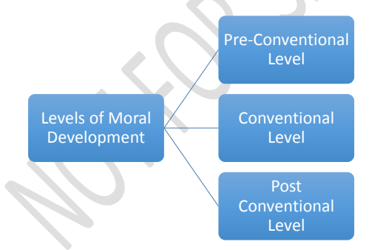
Continued..

Slide 22
Pre-Conventional Level
The first level of moral thinking, which is generally found at Elementary school level.
The thinker at this stage tends to think and behave based on the direct consequences that might occur.
There are two sub-stages in this.
Avoid Punishments: A thinker at this stage generally thinks and believes that the judgment are to be made as per the socially acceptable norms as they are said so by some higher official.
Self–interest: A thinker at this stage, shows interest in making decisions according to the rewards they get in exchange.

Slide 23
Conventional Level
The second level of moral thinking, which is generally found at the primary and high school level.
The thinker at this stage tends to think and behave based on the want to please others.
Two sub-stages
Getting people to like them: Whatever the result is, the thinking process is based on how to impress others or society and on how to please the people around. This decision may or may not support the law.
Maintain functioning in society: A thinker at this stage, considers to follow the rules for the good of the society.

Slide 24
Post-Conventional Level
The third level of Moral thinking, which is generally found after the high school level.
The thinker at this stage tends to think and behave based on a sense of justice.
Two sub-stages
Reject rigidity of laws: The thinker uses his moral thinking skills at a commendable pace.
Sense of justice: The thinker feels a sense of justice for the protagonist.

Slide 25
GILLIGAN’S THEORY
An advancement of Kohlberg’s theory.
Kohlberg’s theory was proposed based on the moral thinking of privileged white men and boys.
Biased upon the male thinking process.
Men had a tendency to solve problems by applying ethical principles
For women, moral development involves caring which shows its effect on human relationships.

Slide 26
Stages of GILLIGAN’S THEORY
Pre-conventional Level
A person in this stage cares for oneself to ensure survival.
Though the person’s attitude is selfish, this is the transition phase, where the person finds the connection between oneself and others.
Conventional Level
In this stage, the person feels responsible and shows care towards other people.
Post-conventional Level
This is the stage, where the principle of care for self as well as others, is accepted.
However, a section of people may never reach this level.

Slide 27
Continued..
Carol Gilligan researched and found that the post-conventional level of thinking is not being easy for women to go through because they care for the relationships.
Levels of Thinking in the post-conventional level
Care-based Morality: Found in women.
Justice-based Morality: Found in men.

Slide 28
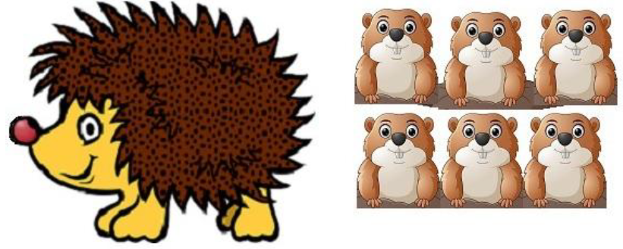
Example
A group of moles give shelter to a porcupine. But they are being continuously stabbed by the porcupine’s quills. Now, what should they do?

Slide 29
Consensus And Controversy
The moral judgment may lead to conflicts
Two stages after the judgement
CONSENSUS
This is that state where people come into agreement with the judgment given and will leave the people with a feel that justice has been done
CONTROVERSY
This is that state where the persons involved in an issue are not satisfied by the verdict and might feel that it was decided on partial interests.
This will leave the people with a sense of dissatisfaction that justice was not done, which might lead to another conflict.

Slide 30
Profession and Professionalism
Profession
Profession means a job or an occupation, that helps a person earn his living.
The main criteria of a profession involves the following.
Advanced expertise
Self-regulation
Public good
Professional
A person who is paid for getting involved in a particular profession in order to earn a living as well as to satisfy the laws of that profession

Slide 31
Continued..
Professionalism
The art of Professionalism can be understood as the practice of doing the right thing, not because how one feels but regardless of how one feels
Professionalism covers comprehensively all areas of practice of a particular profession.
It requires skills and responsibilities involved in engineering profession.
Professionalism implies a certain set of attitudes

Slide 32
Models of Professional Roles
Engineer has to play many roles while exercising his professional obligations.
Engineers as Saviors: Improves society through technological developments.
Engineers as Guardians: know the direction & Speed in which technology should develop.
Engineers as Bureaucratic Servants: receives and translates the directives of management into solid accomplishments.
Engineers as Social Servants
Engineers as Social Enablers and Catalysts: help the management and the society to understand their needs.
Engineers as Game Players: engineers are neither servants nor masters of anyone.

Slide 33
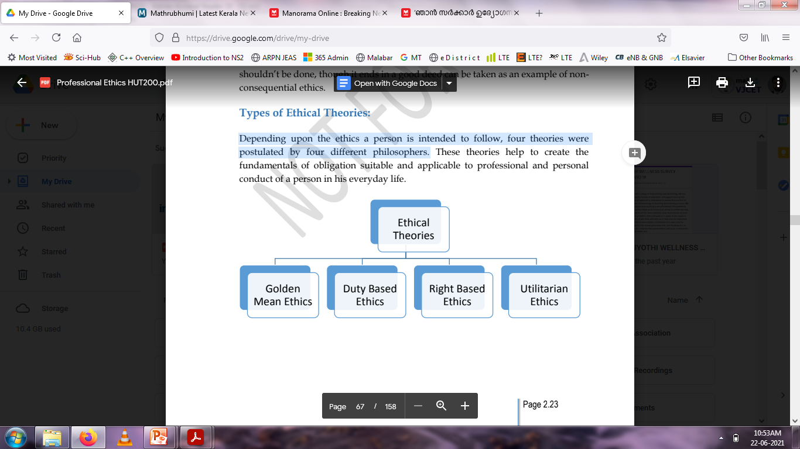
Theories About Right Action
Depending upon the ethics a person is intended to follow, four theories were postulated by four different philosophers.

Slide 34
Continued..
Golden Mean
proposed by Aristotle.
The solution to a problem is found by analyzing the reason and the logic.
A “Mean value of solution” between the extremes of excess and deficiency.
Duty-based Ethical Theory
Proposed by Immanuel Kant.
Every person has a duty to follow which is accepted universally, with no exceptions.

Slide 35
Continued..
Rights-based Ethical Theory
Proposed by John Locke.
The solution to a problem is by realizing that every person has a right to live.
Live and let live is the philosophy behind this theory.
The rights of a person towards life, health, liberty, possession, etc. are taken care of under this theory.

Slide 36
Continued..
Utilitarian Ethics
Proposed by John Stuart.
The happiness or pleasure of a greatest number of people in the society is considered as the greatest good.
According to this philosophy, an action is morally right if its consequences lead to happiness of people and wrong if they lead to their unhappiness.

Slide 37
Formulation of Ethical Theories
Consider the following points:
The concepts of the theory formulated must be coherent.
The tenets of the theory should never contradict the other.
The theory should never be defended upon false information.
The theory should guide in specific situations comprehending all aspects possible.
The theory should be compatible with individual’s moral convictions in any situation.

Slide 38
Self-Interest
Self-interest is nothing but one’s personal good.
It refers to the goodness of oneself in the long run.
Each of the ethical theories recognizes the importance of self-respect.
The pursuit of self – interest must be balanced and kept under control by moral responsibilities to other people.
Ethical Egoism
Morality essentially needs a willingness on the part of both individuals and corporations to place some restrictions on the pursuit of private self – interests.

Slide 39
Customs and Religions
Ethical pluralism
It views that there may be alternative moral attitudes that are reasonable.
Ethical relativism
Actions are morally right when they are approved by law or custom and they are said to be wrong when they violate laws or customs.
Reasons for accepting ethical relativism
Laws and customs seem to be definite, real and clear – cut.
It believes the values are subjective at the cultural level.
Moral relationalism or moral contextulaism.

Slide 40
Continued..
Religion and Divine Command Ethics
They are related historically.
Religions or religious hopes imply trust. This trust gives an inspiration to be moral.
Religion supports many people to follow their beliefs and promote tolerance and moral concern for others.
Religions form a set of higher moral standards.

Slide 41
Uses of Ethical Theories
Aid in identifying the moral considerations or reasons that constitute a dilemma.
Provide a precise sense of what kinds of information are relevant to solving moral development.
Offer ways to rank the relevant moral considerations in order of importance and provide a rough guidance in solving moral problems.

Slide 42
Continued..
Help us identify the full moral ramifications of alternative courses of action, urging a wide perspective on the moral implications of the options and providing a systematic framework of comparing alternatives.
Augment the precision with which we use moral terms and they provide frame works for moral reasoning when discussing moral issues with colleagues.
Strengthen our ability to reach balanced and insightful judgments.

